Slide 1
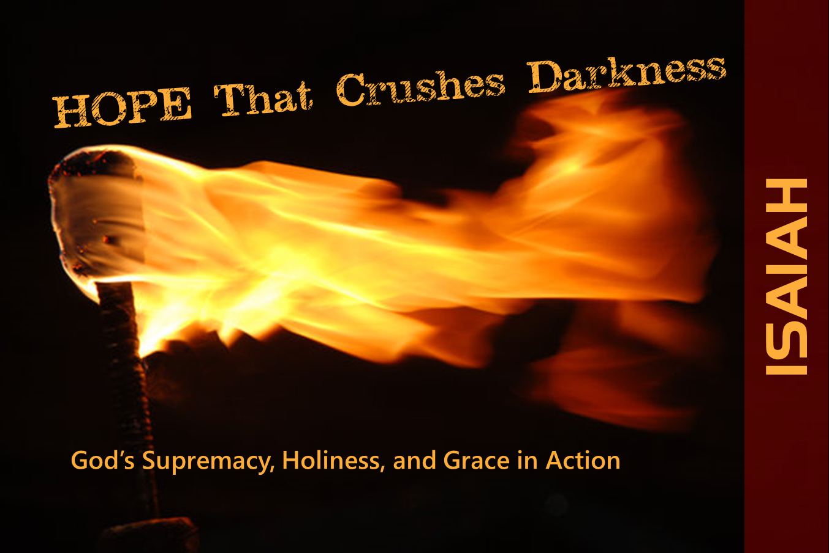

Slide 2
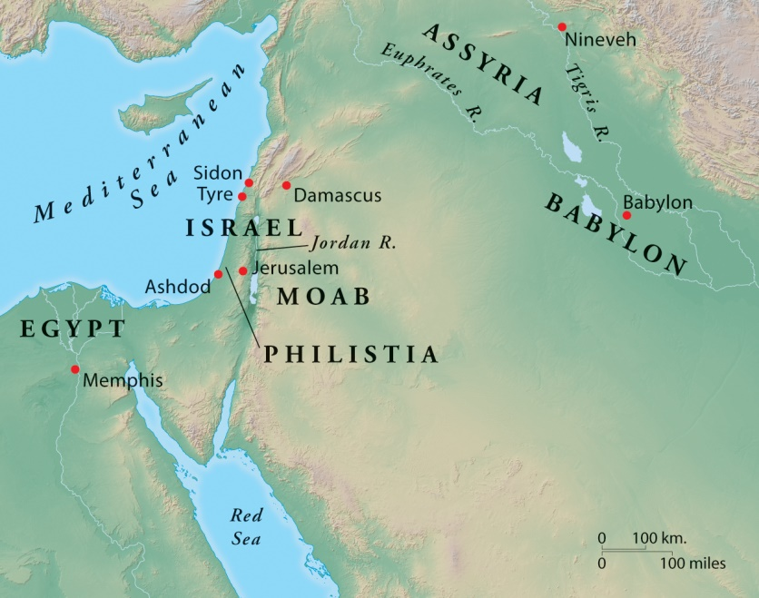
Babylon – God powerfully punishes arrogance and pride
CUSH

Slide 3
Assyria – God is sovereign even over our wonderful, foolproof plans
CUSH

Slide 4
Philistia – Don’t get confident and trust in good times: Only God provides refuge
CUSH

Slide 5
Moab – God provides salvation, don’t let pride keep you from surrendering to Him
CUSH

Slide 6
Damascus (and Ephraim) – Beware of worshiping and trusting the created rather than the creator
CUSH

Slide 7
Cush – God is always working, so instead of taking matters into your own hands, listen for God’s message and look for His work
CUSH

Slide 8
Egypt – Your idols, money, and wisdom are foolish and cannot save you
CUSH

